Slide 1




(21CC505PC) SOFTWARE ENGINEERING LAB
UPPAL CAMPUS
NARAYANGUDA
IBRAHIMPATNAM
LAB EXERCISE - 5
BUILD TOOLS
TOPIC -3
CREATING MAVEN WEB PROJECT USING ECLIPSE AND PUSH INTO TO GITHUB
BY
B MADHURIKA(Ph.D.)
Assistant Professor
CSE

Slide 2

SOFTWARE ENGINEERING LAB
(21CC505PC)
BY
MADHURIKA BUDARAJU(Ph.D.)
ASSISTANT PROFESSOR
CSE
KMIT

Slide 3
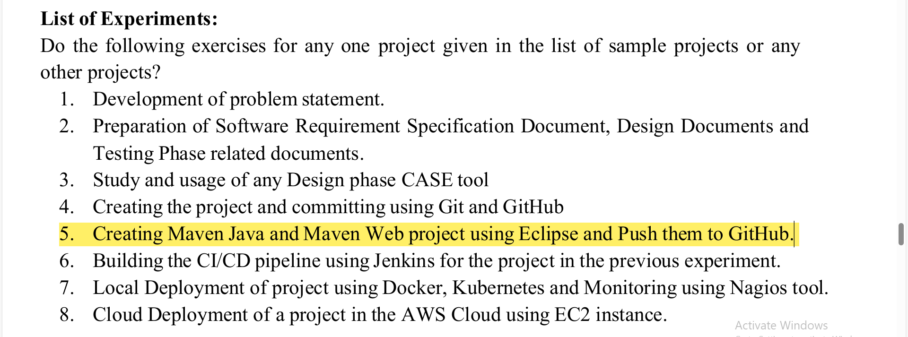

Slide 4
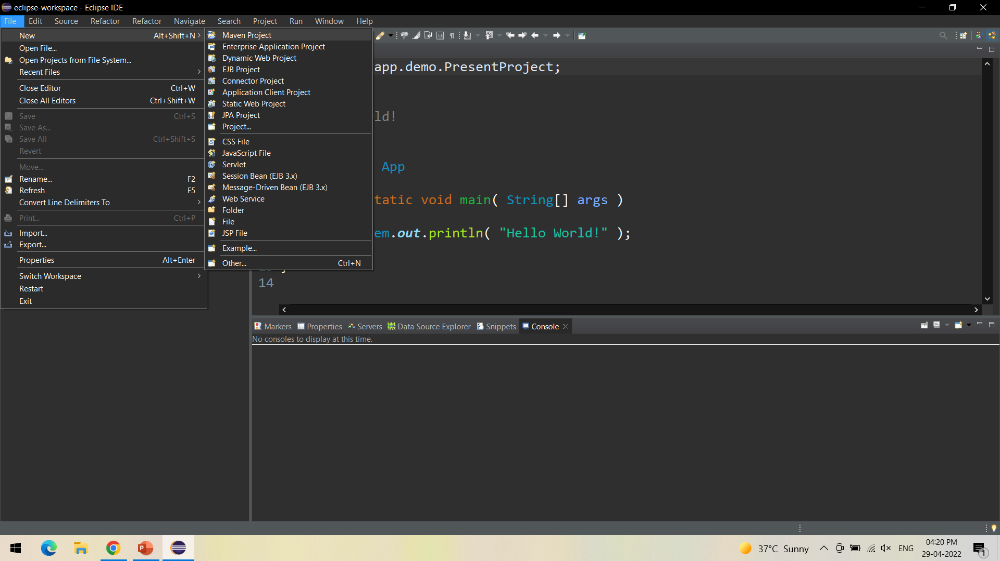

Slide 5
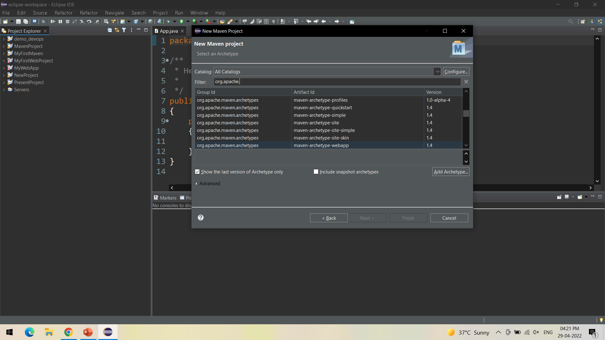

Slide 6
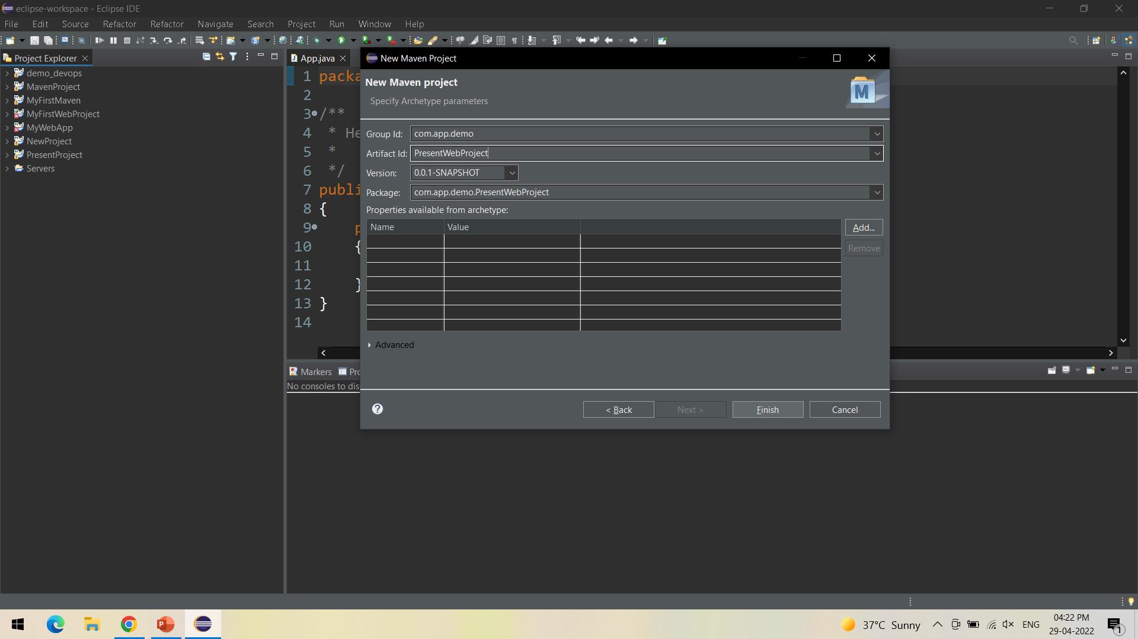

Slide 7
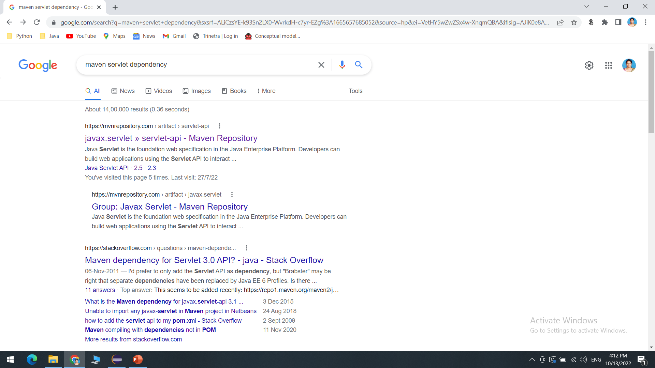
In pom.xml add the dependencies as shown below.
Maven Web Project in Eclipse

Slide 8
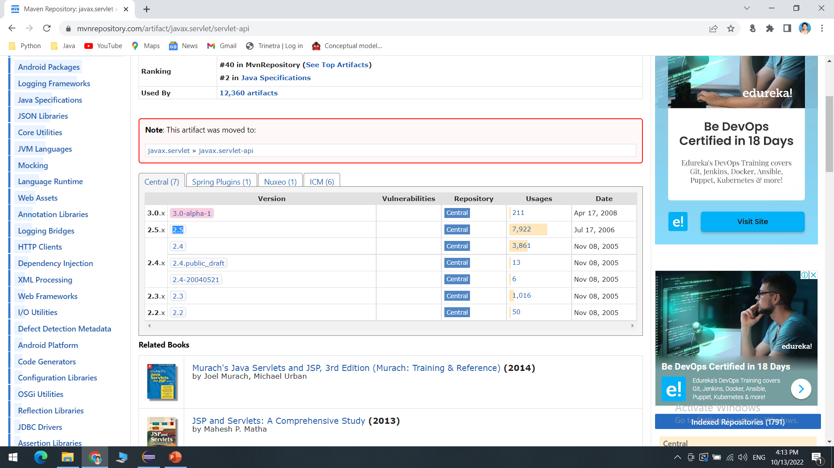
In pom.xml add the dependencies as shown below.
Maven Web Project in Eclipse

Slide 9
In pom.xml add the dependencies as shown below.
Maven Web Project in Eclipse
<dependency>
<groupId>javax.servlet</groupId>
<artifactId>servlet-api</artifactId>
<version>2.5</version>
</dependency>

Slide 10
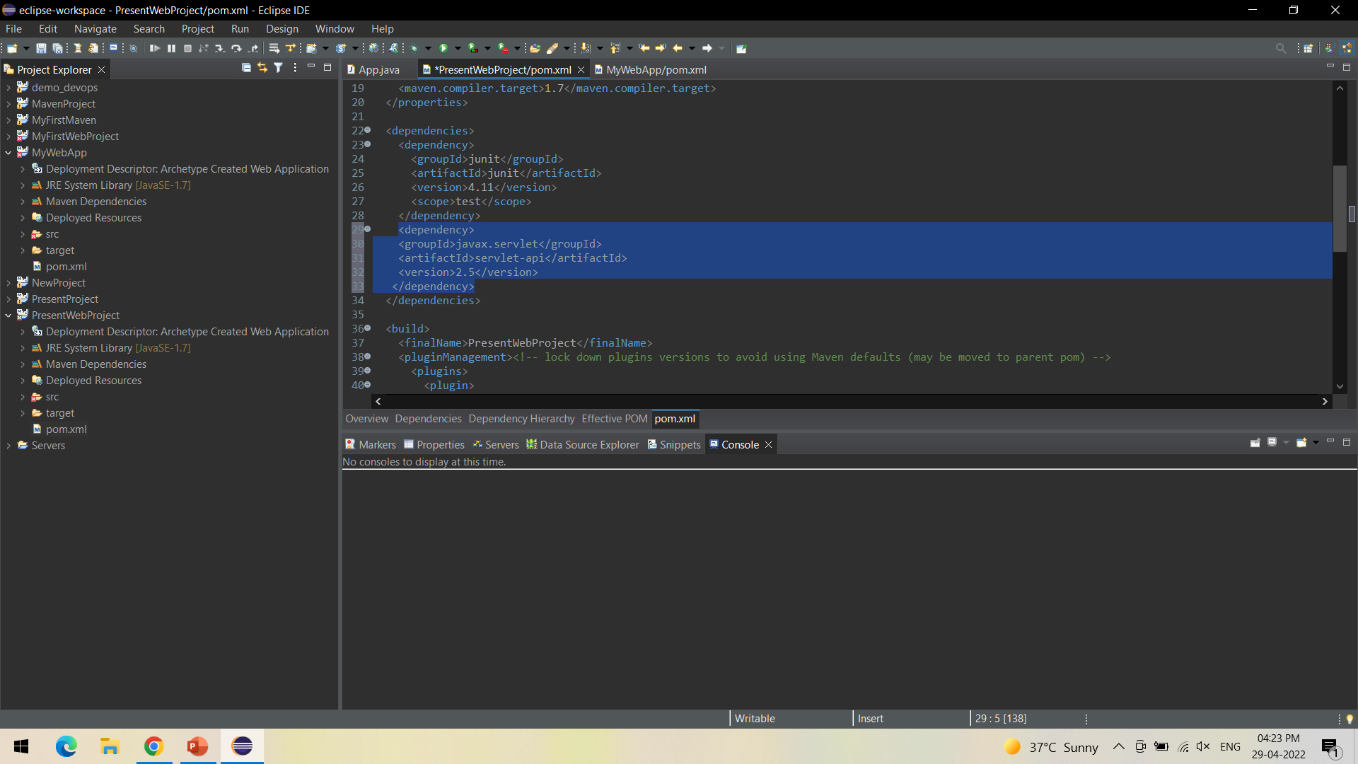

Slide 11
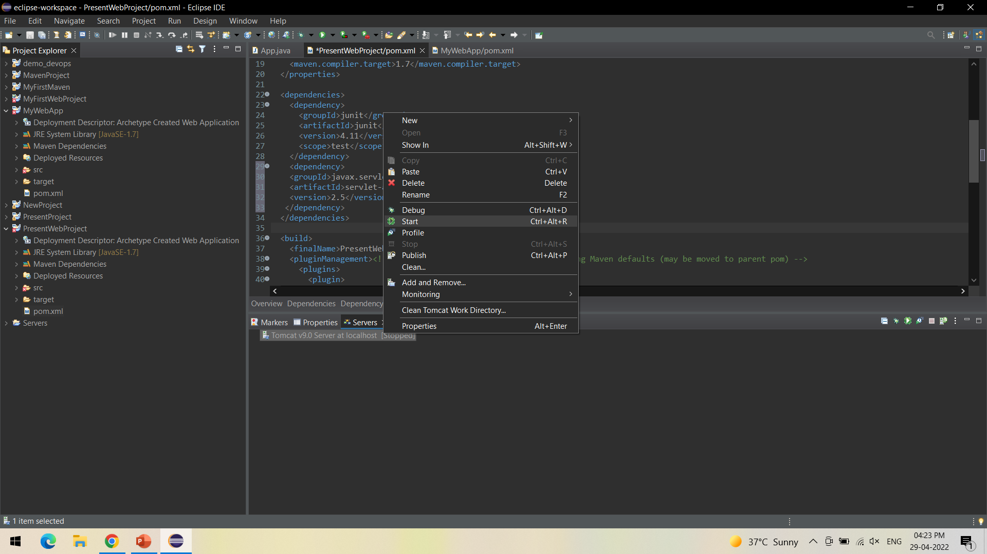

Slide 12
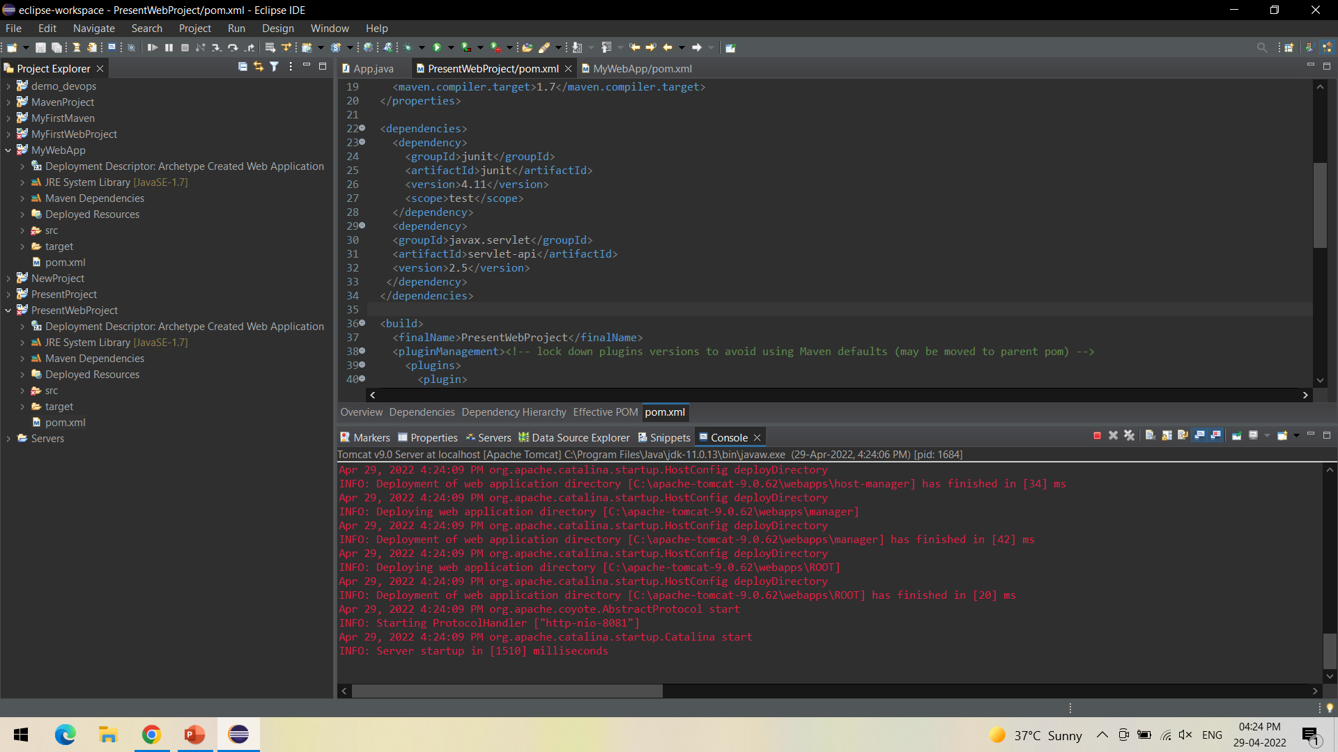

Slide 13
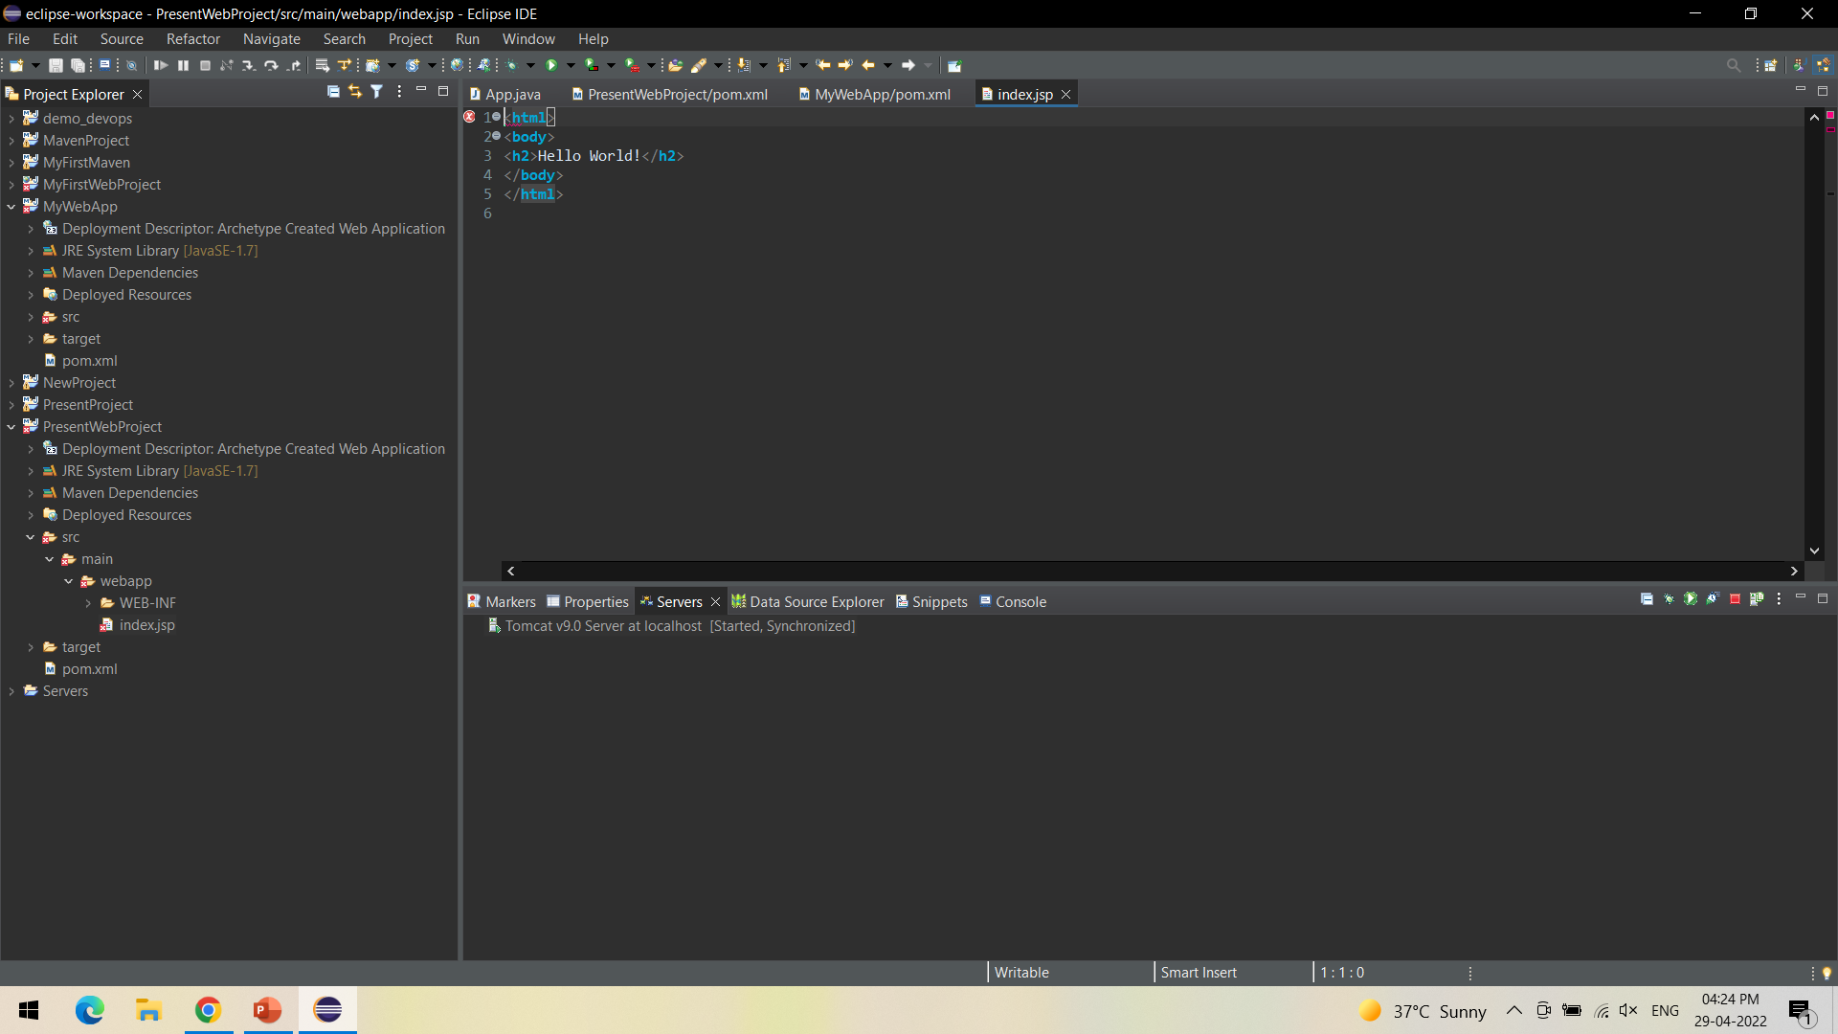

Slide 14
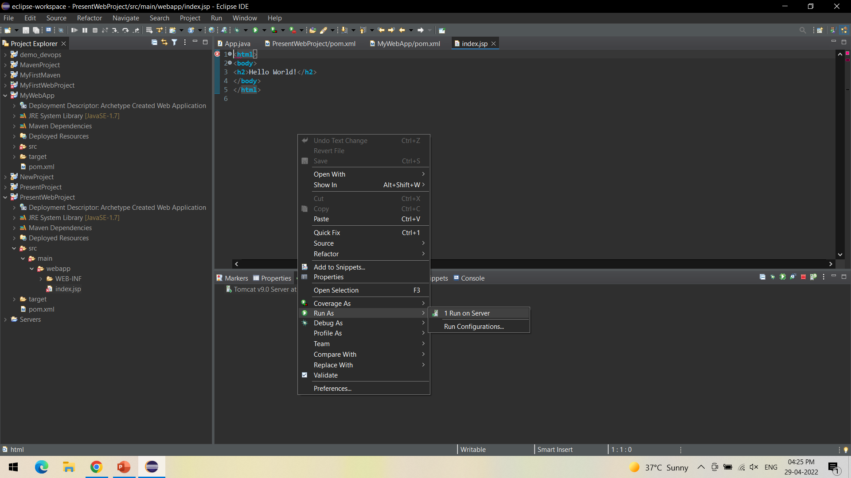

Slide 15
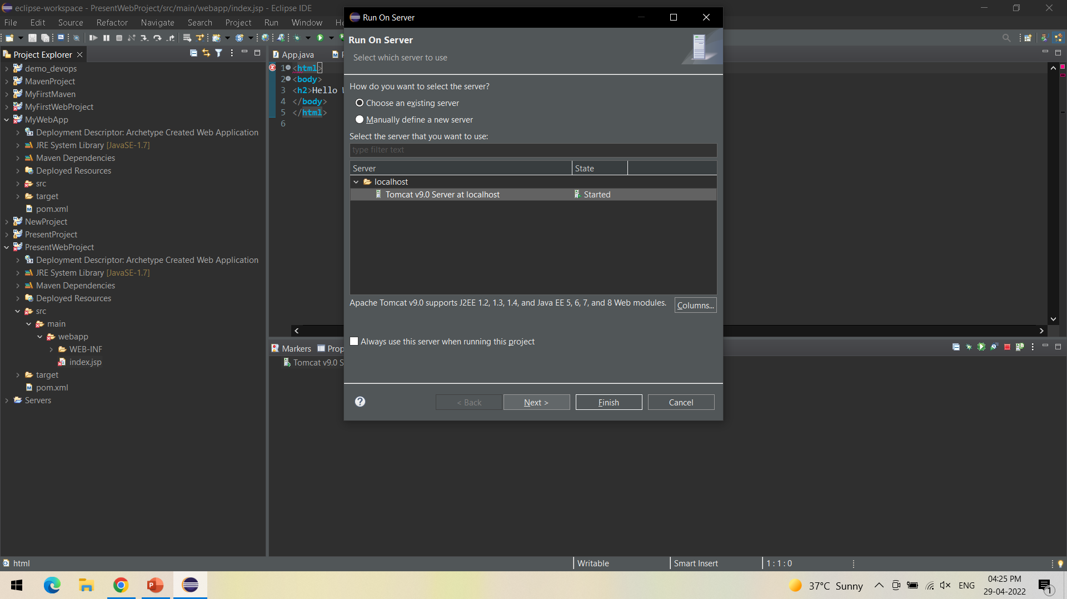

Slide 16
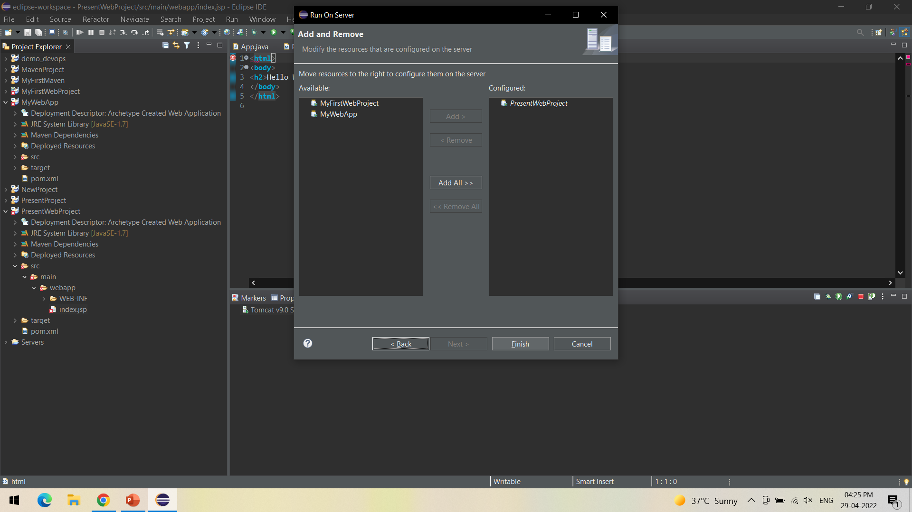

Slide 17
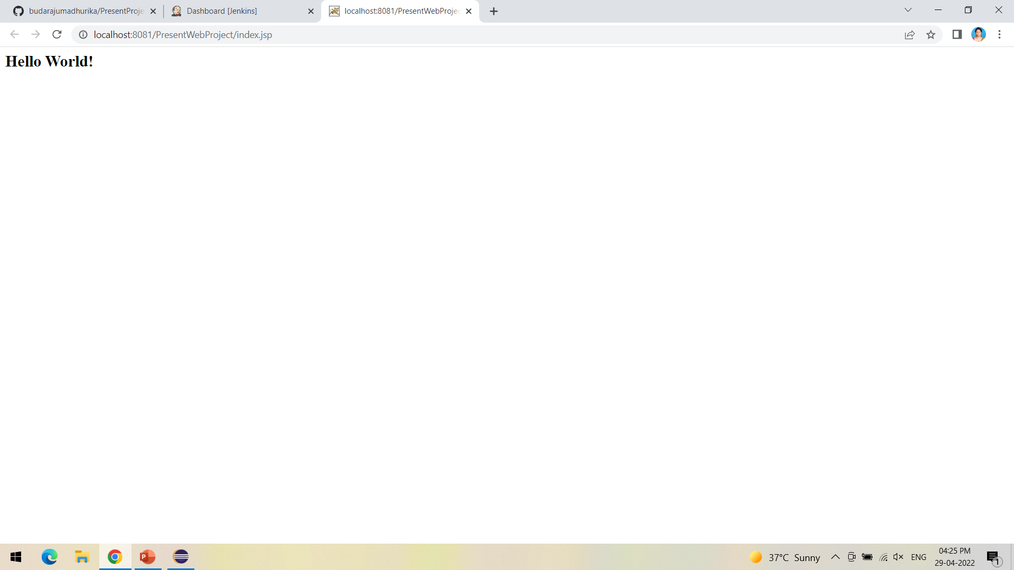

Slide 18
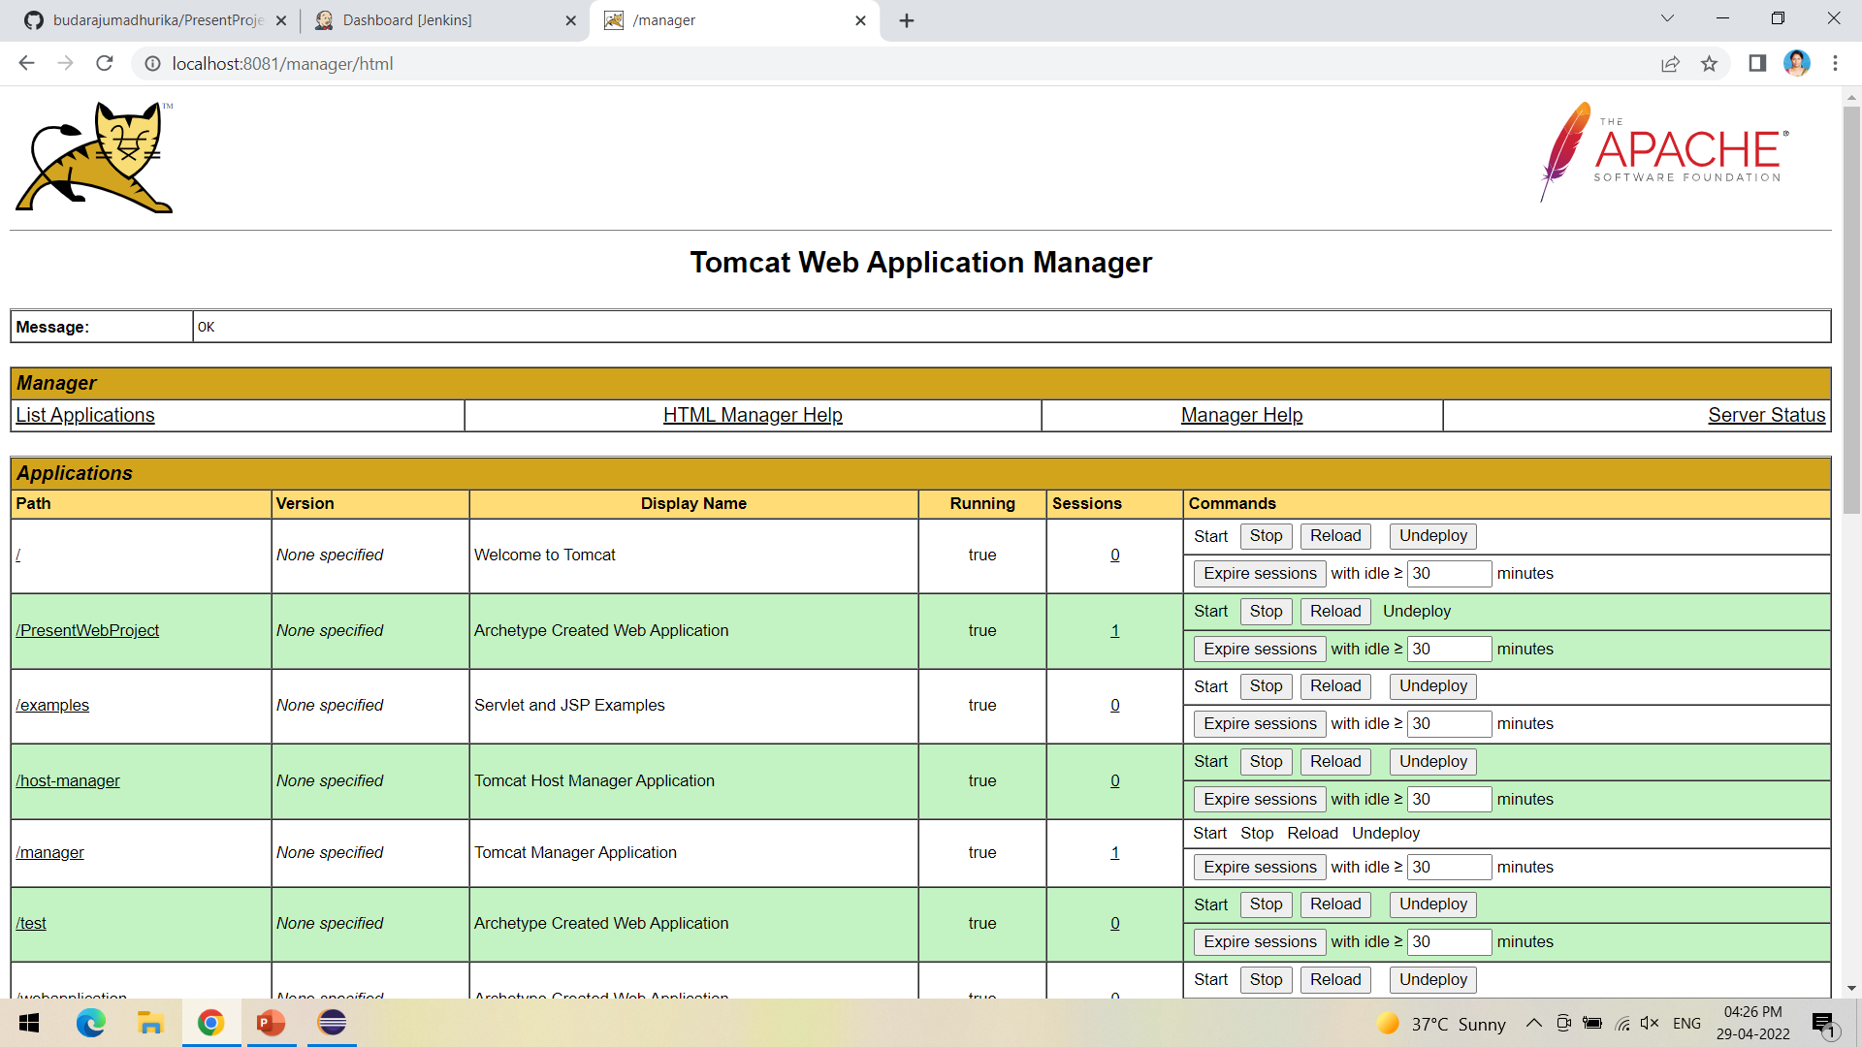

Slide 19
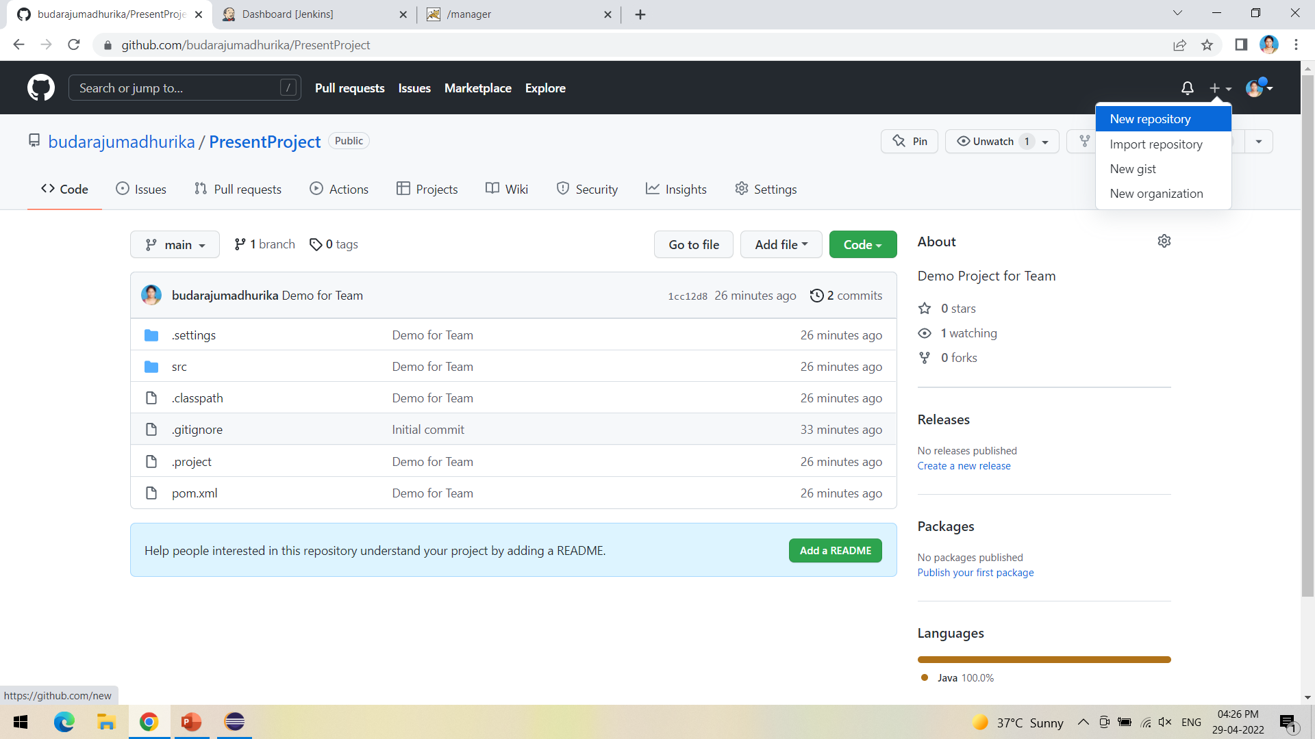

Slide 20
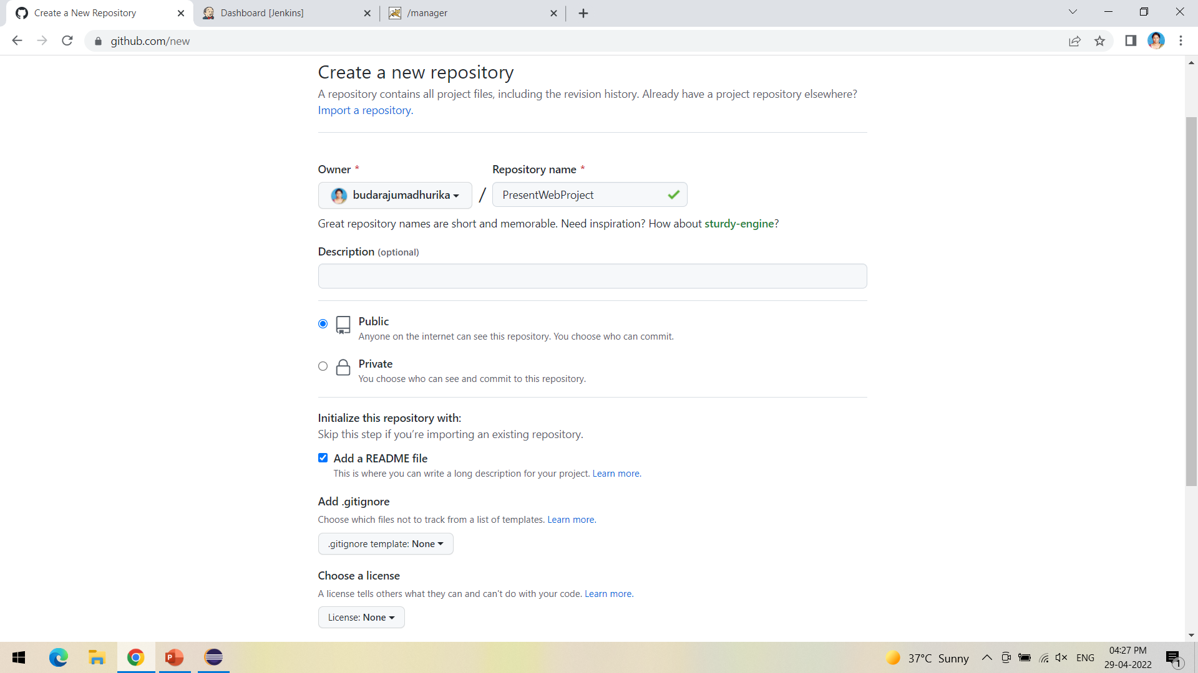

Slide 21
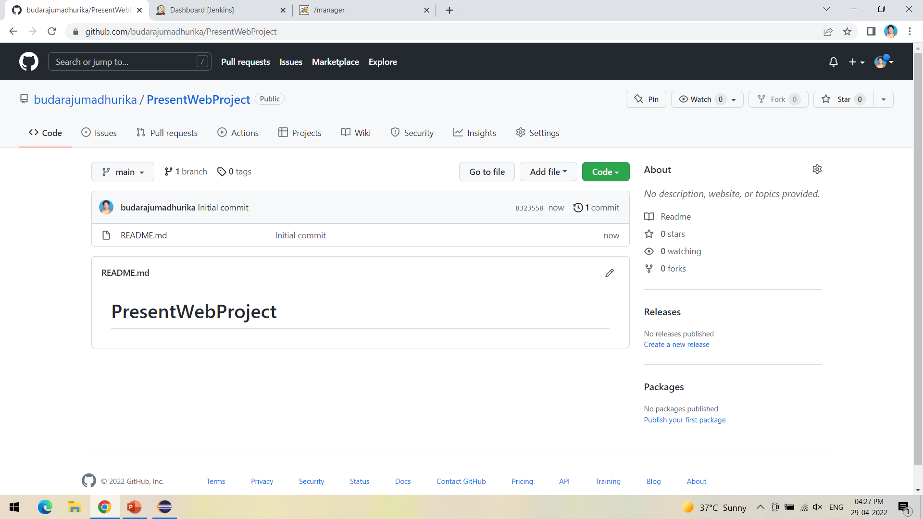

Slide 22
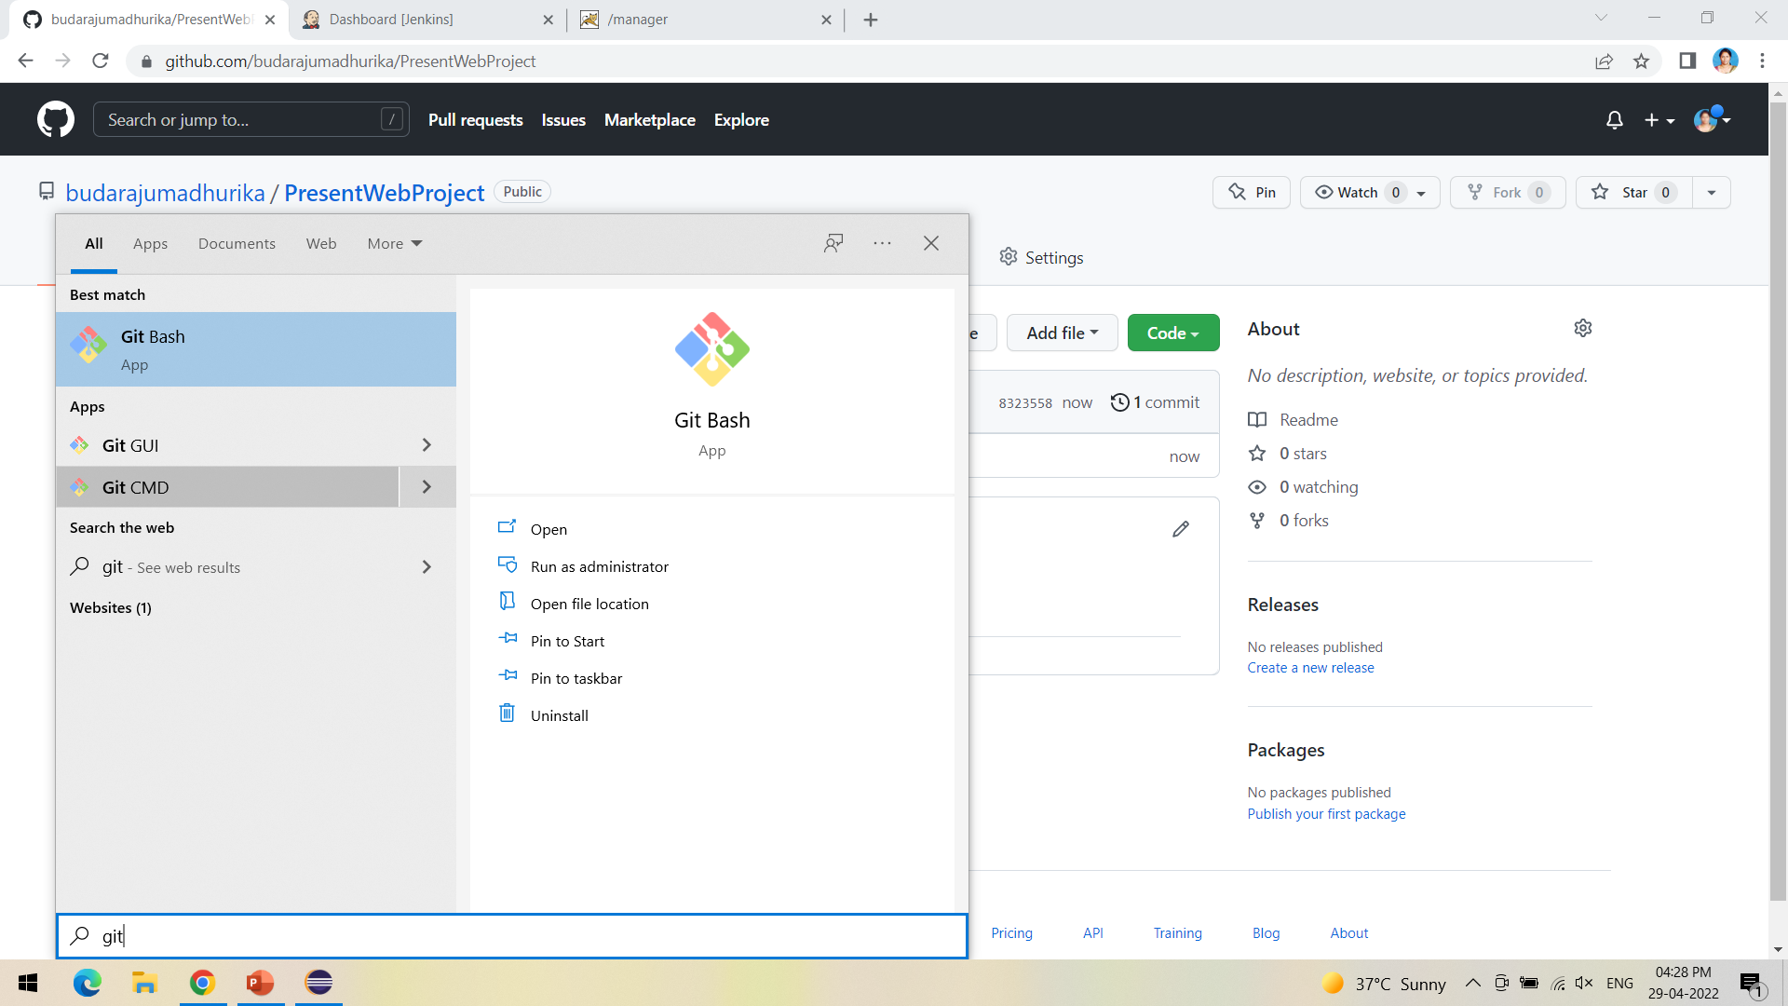

Slide 23
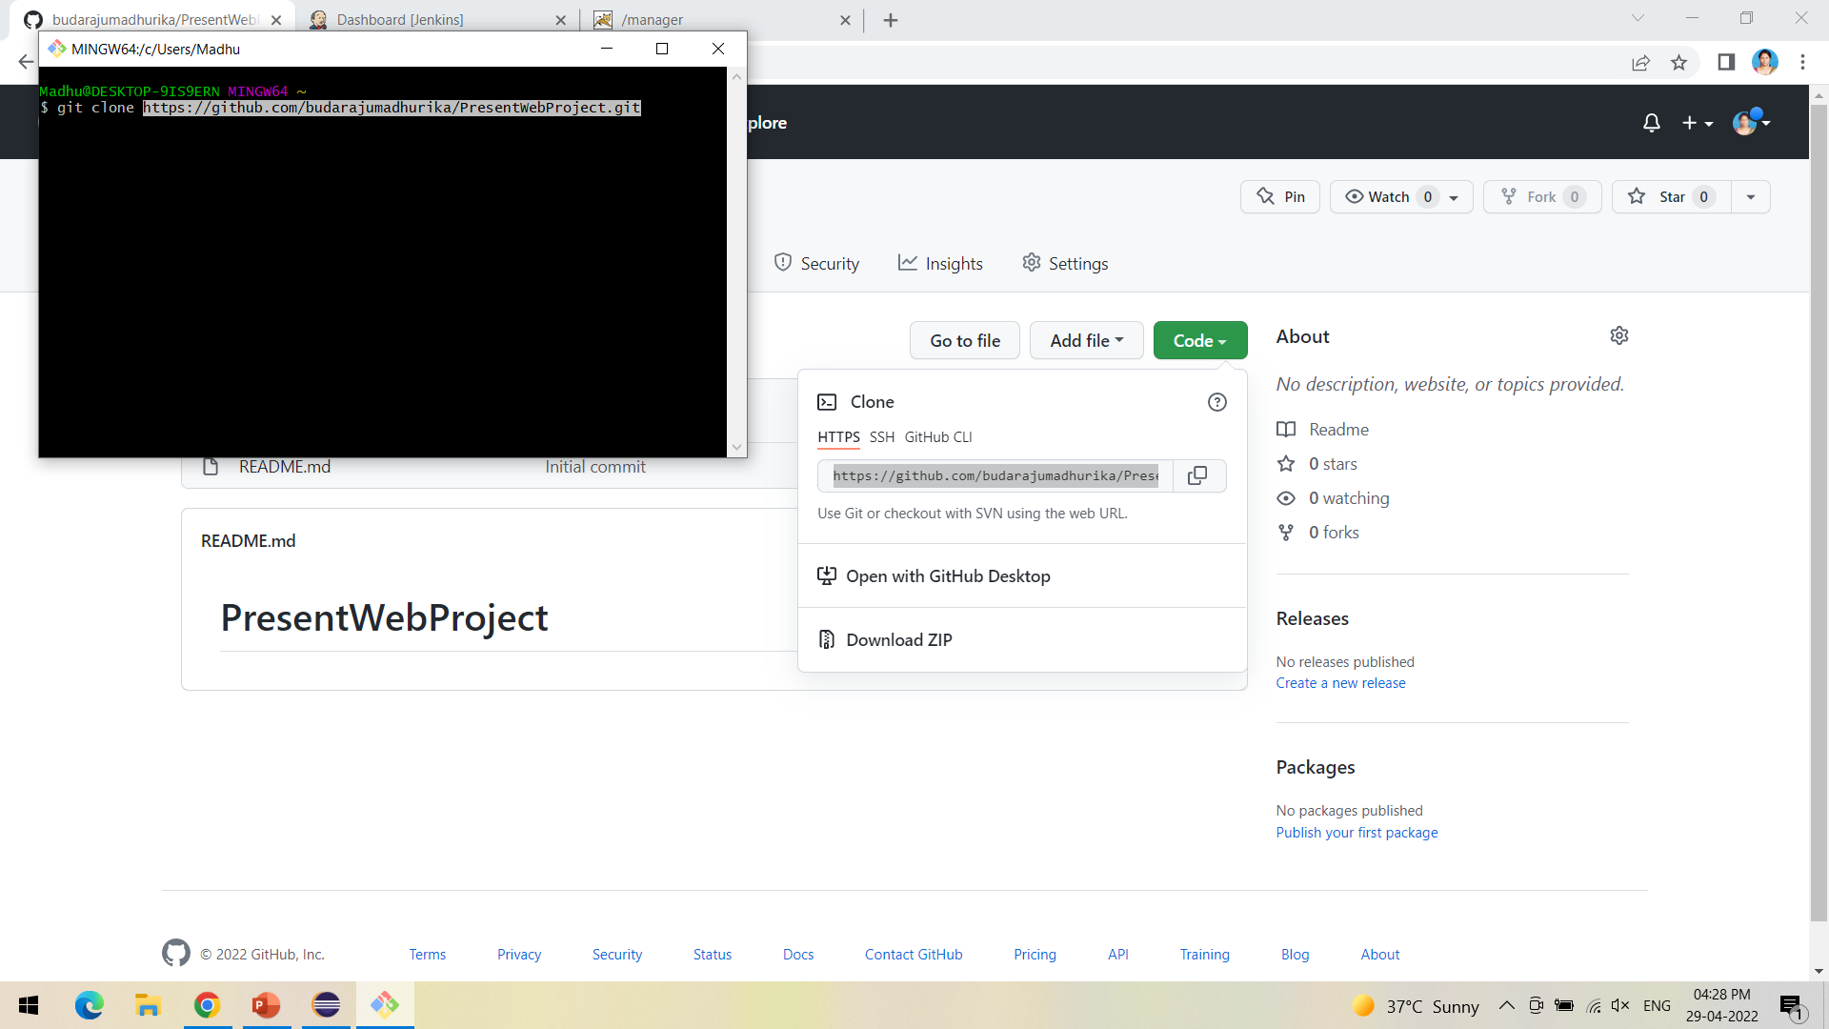

Slide 24
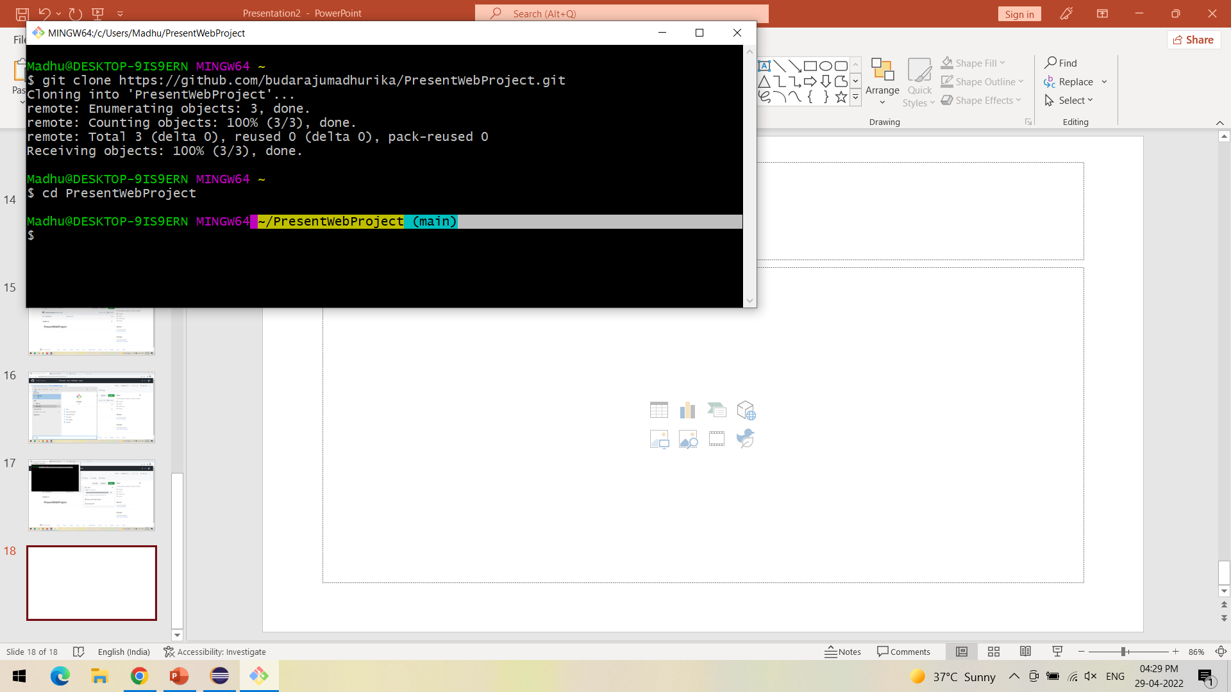

Slide 25
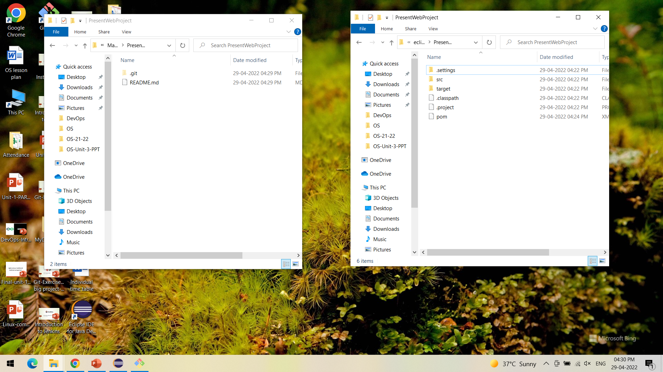

Slide 26
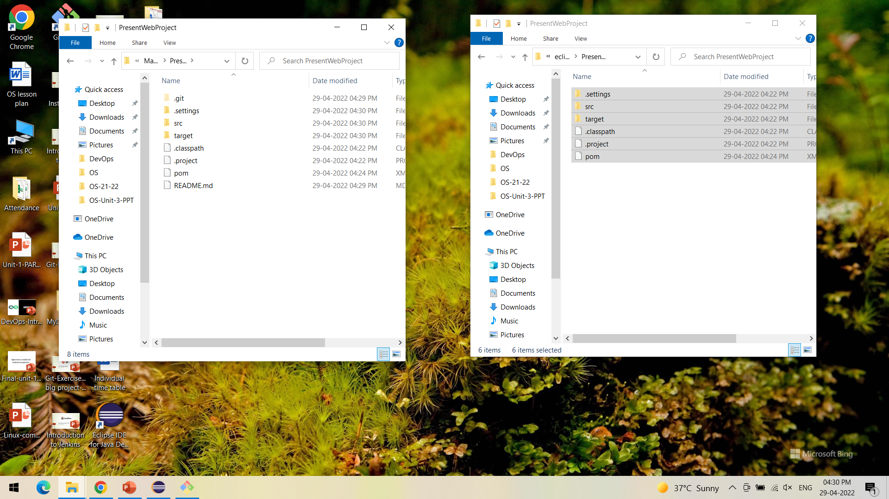

Slide 27
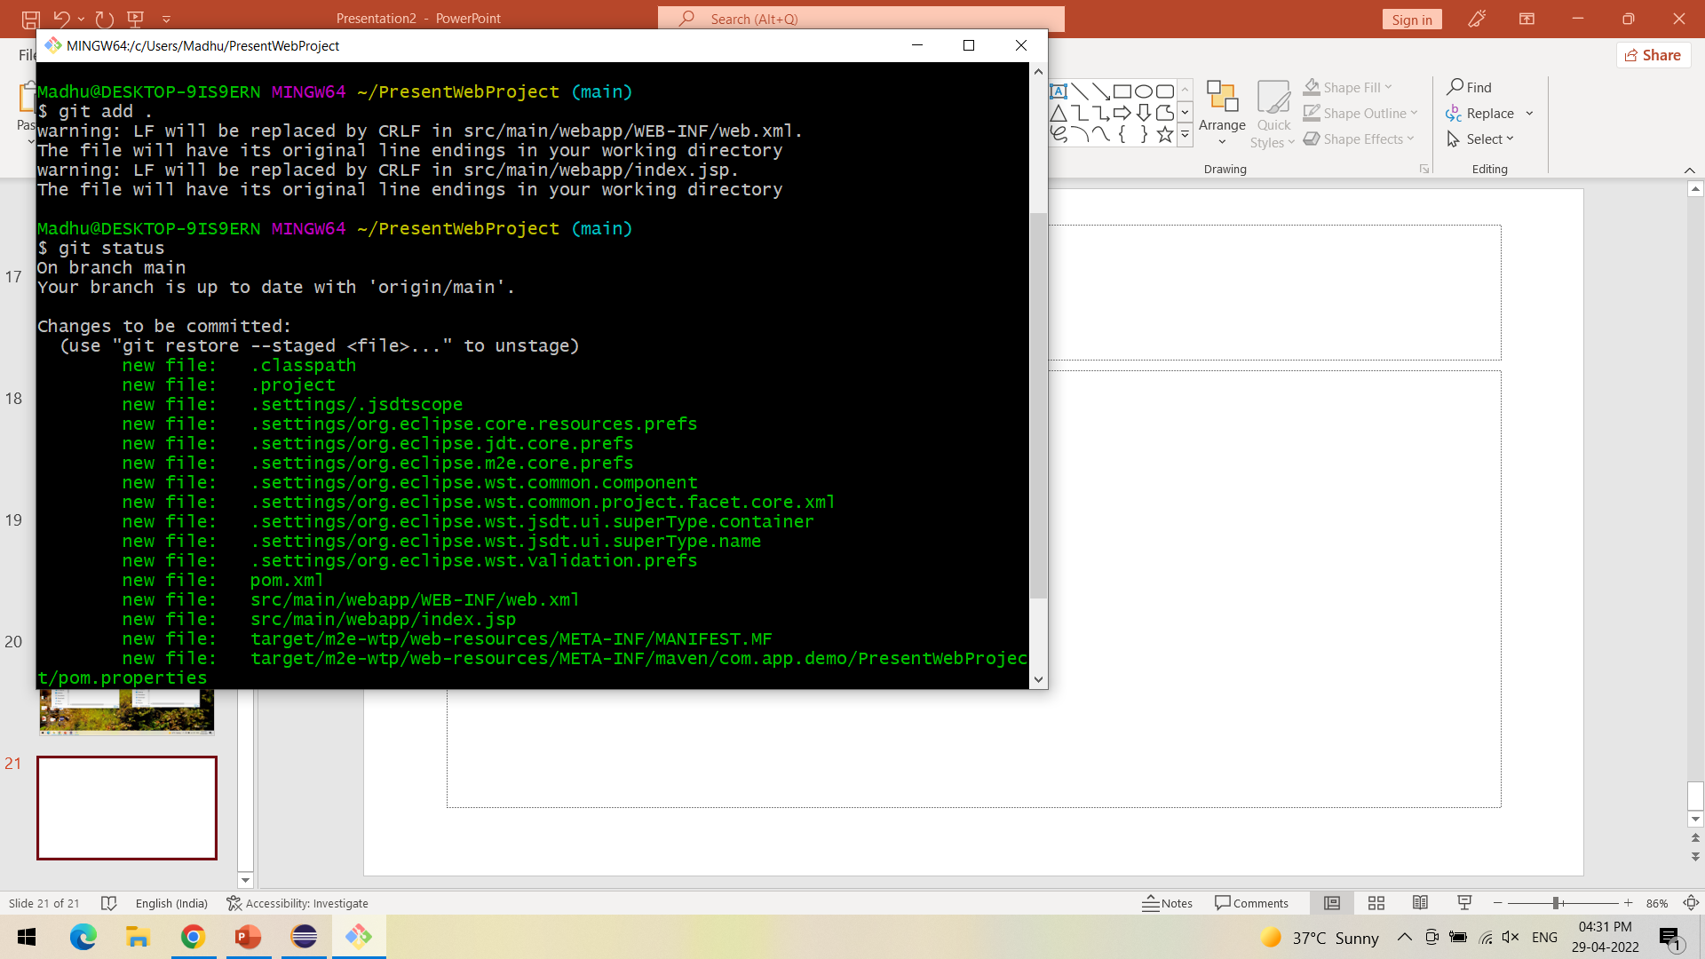

Slide 28
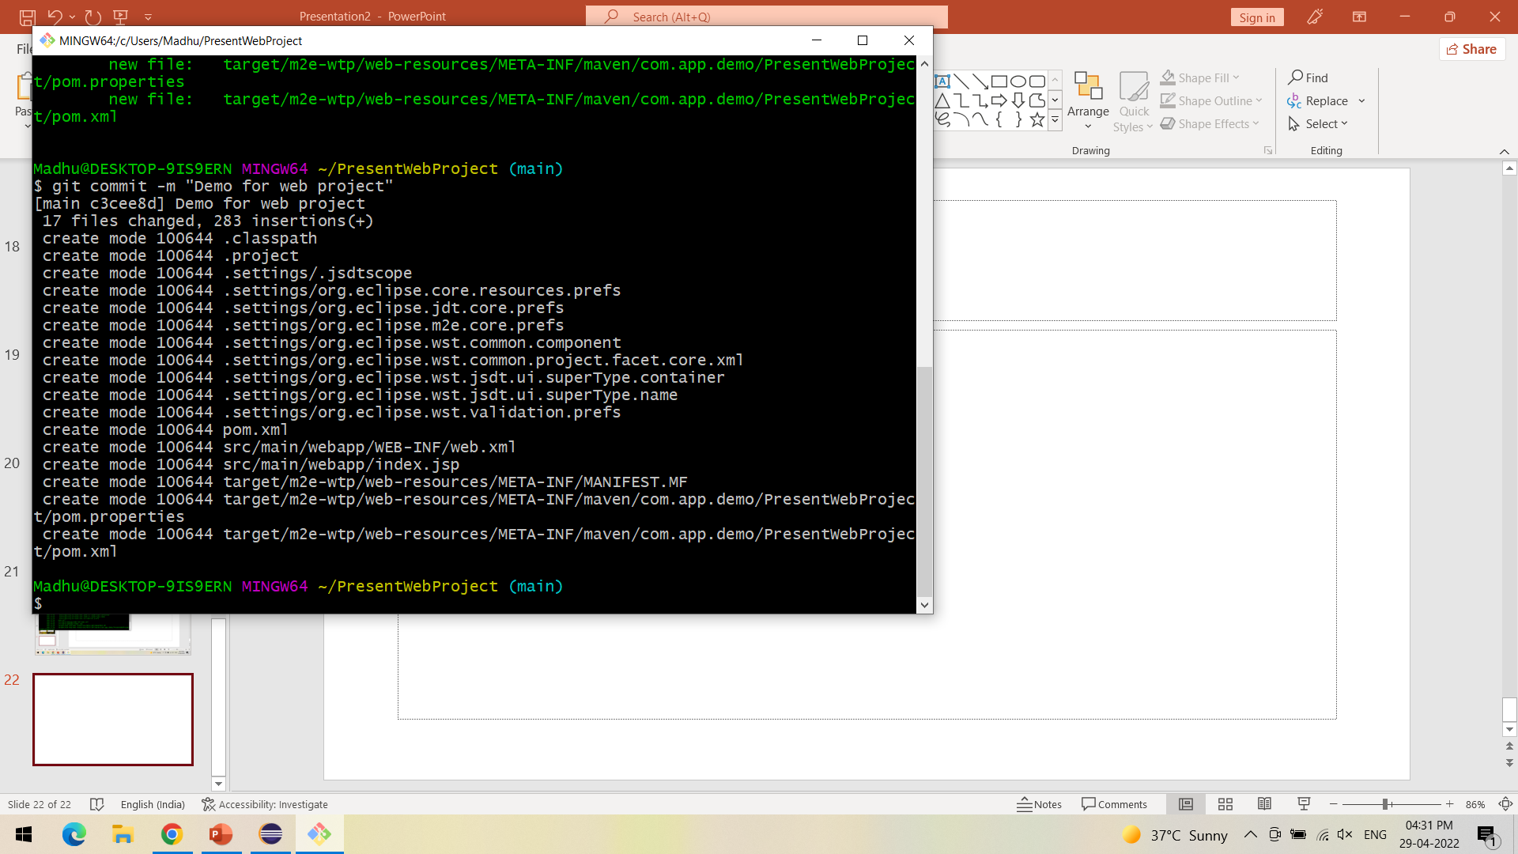

Slide 29
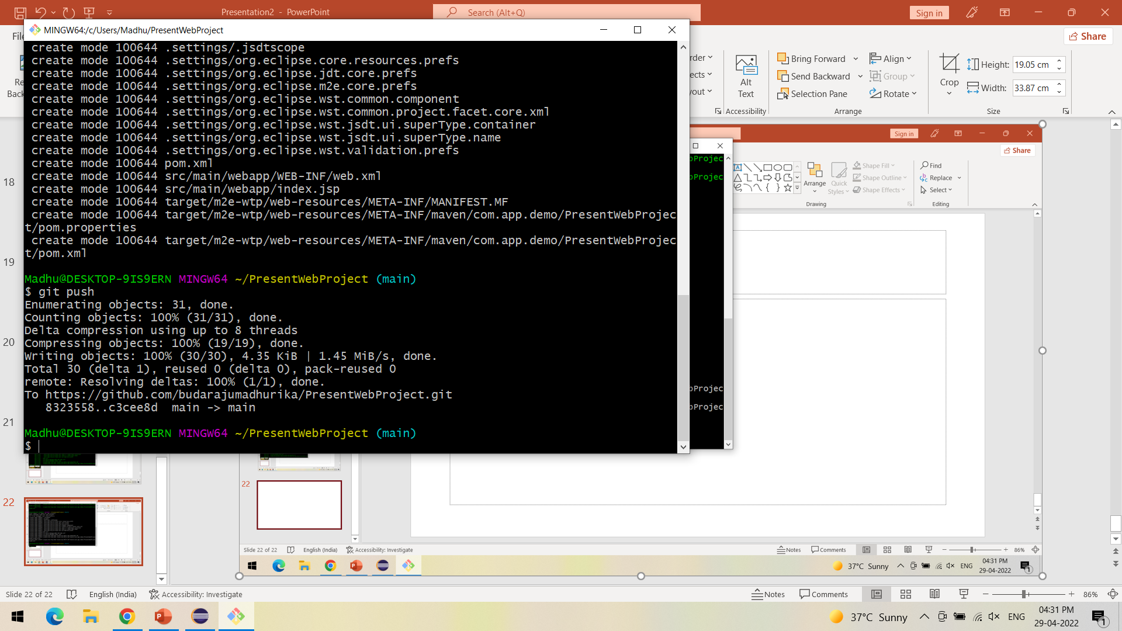

Slide 30
